Slide 1


Notes:
Hi we are a special task force set up to fix the unprofitability of Uber pool. and here we are presenting our new product that's all set to launch.
We are team 4 (having Kelly, peifen, Tony, rish and shalaka).

Slide 2


Year: 2017
Uber Pool
Pooling in Peril: Profits Plunge as 2016 Draws to a Close
Greedy Algorithm
High Rider Uptake
Loops & Detours
Poor Ratings
Notes:
Lets go before pandemic, in 2017, we realised that uber pool was unprofitable bcz of its greedy algorithm which led to high rider rate causing detours - that led to frustration and decrease in customer satisfaction that led to poor rating of drivers. Using this feedback, we built the next generation of shared rides.

Slide 3
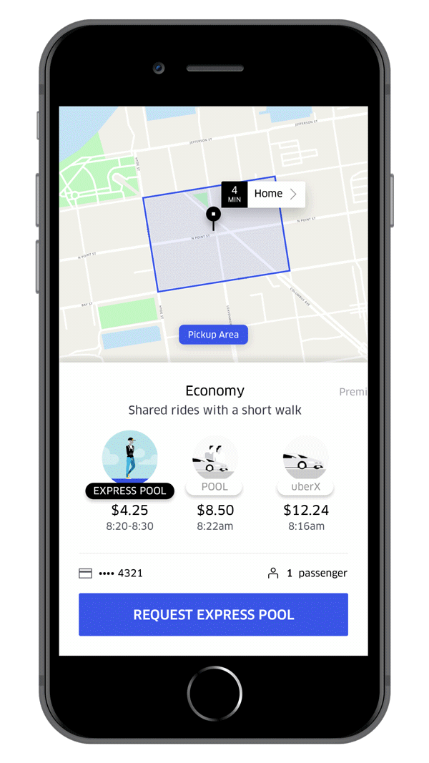
Solution
Introduce a two-minute waiting period for batch matching of co-riders.
Encourage riders to walk short distances to and from their pick-up and drop-off points.
New Product
Uber Express Pool = CarPool + Walk & Wait
Notes:
To alleviate the identified user pain points and improve the ride co-rider matching, here is our solution.
For this, we propose 2 strategies: (read strategy from slide)
We present to you the new Uber Express Pool which is CarPool with some walk and wait.

Slide 4
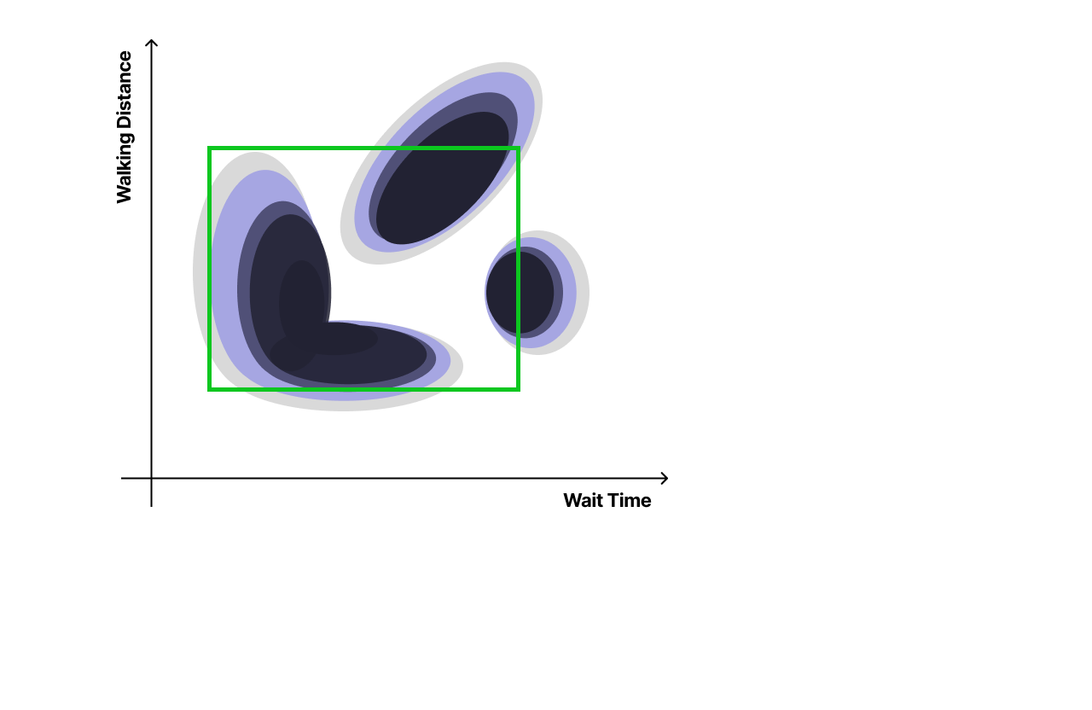
Our Approach
find optimal walking distance and wait time
to limit the product design
Data Sources
Surveys
Simulation
Experiments
Notes:
the approach we took was to decide scope of product.
we did interview survey + simulation + experiments to understand pain points of users and drivers
So let's move to rish for the analysis.

Slide 5

Assumptions
Express over Pool
Lower trip cancellations
Lower Cost Per Trip Expected
Increased matches
Express over Pool
Higher trip cancellations
Lower Cost Per Trip Expected
Increased matches
Rush Hour
Pool over Express
Lower trip cancellations
Higher Cost Per Trip Expected
Reduced matches
Pool over Express
Higher trip cancellations
Higher Cost Per Trip Expected
Reduced matches
Not Rush Hour
Lower Wait Time
Higher Wait Time

Slide 6


Metrics
Customer Experience Metrics
Product Efficiency Metrics
Count of Rider Cancellations
Cost Per Trip
Count of Express Trips
Count of Matches

Slide 7

The Experiment
Switchback Experiment to assess the impact of wait time variations on user experience and efficiency.
The experiment involved altering wait times after a set period:
Control group: Riders waited up to two minutes.
Treatment group: Riders waited up to five minutes.
Data was collected after two weeks to assess experiment outcomes.
Analysis Focus: How the increase in wait times from 2 to 5 mins affected user satisfaction, trip completion rates, and overall efficiency of the ride-sharing service.

Slide 8
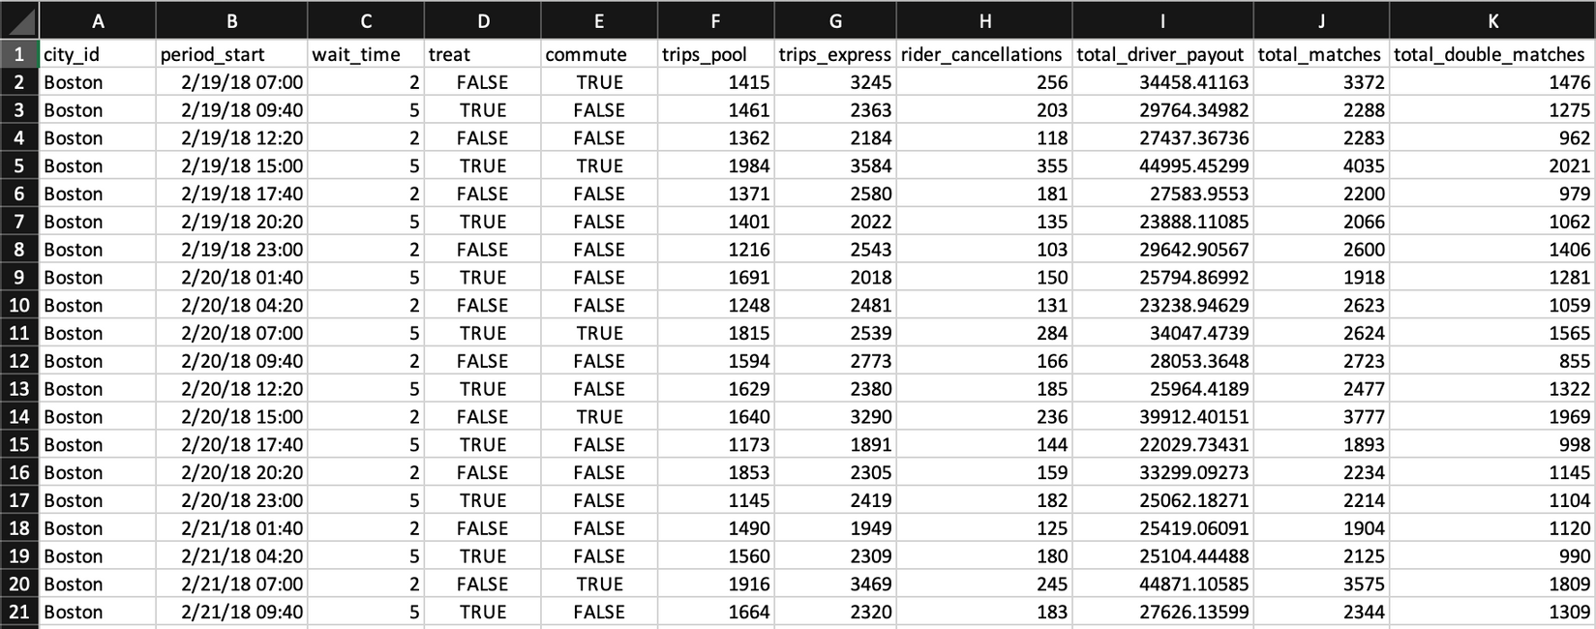
The Dataset
trips_pool: Total completed POOL trips in the current time period.
trips_express: Total completed Express POOL trips in the current time period.
rider_cancellations: Total rider-cancelled trip requests in the current time period.
total_driver_payout: Total dollars paid to drivers for completed trips in the current time period.
total_matches: Total completed trips paired with at least one other rider during the current time period.
total_double_matches: Total completed trips paired with at least two other riders during the current time period.

Slide 9

Data Analysis
Investigate The Distribution Of Data Points
Verify The Underlying Assumptions
Assess The Impact Of The Treatment On Metrics

Slide 10
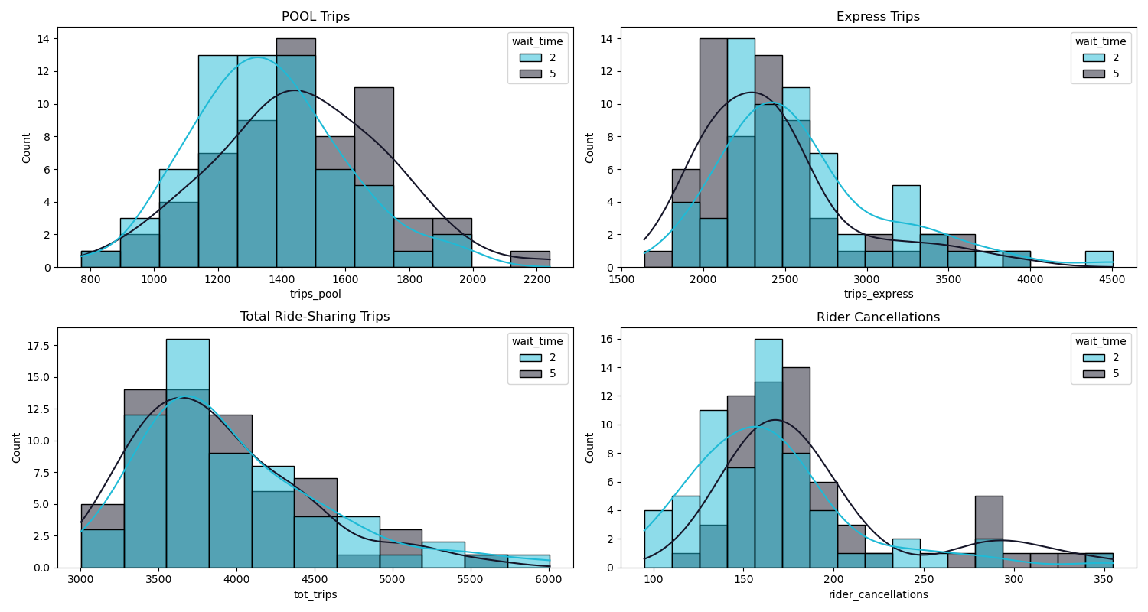
Data Distribution

Slide 11
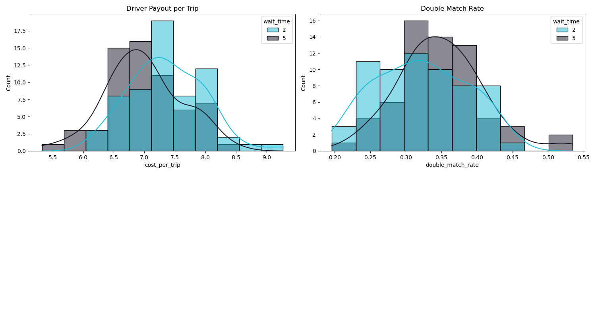
Data Distribution
High-level observation: Distinct peaks and density plots highlight the differences between groups* across all observed variables.
*categorized by the treatment variable (wait time)

Slide 12
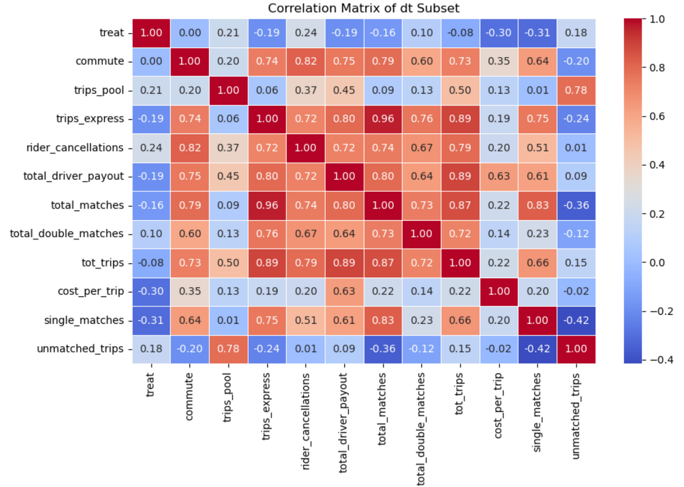
Data Distribution
Interesting observations:
‘commute’ and ‘treat’ variables have 0 correlation.
‘commute’ is heavily correlated with cancellations, driver payout and ride matches.
commute: TRUE Indicates rush hour periods (7-9:40AM or 3-5:40PM).

Slide 13
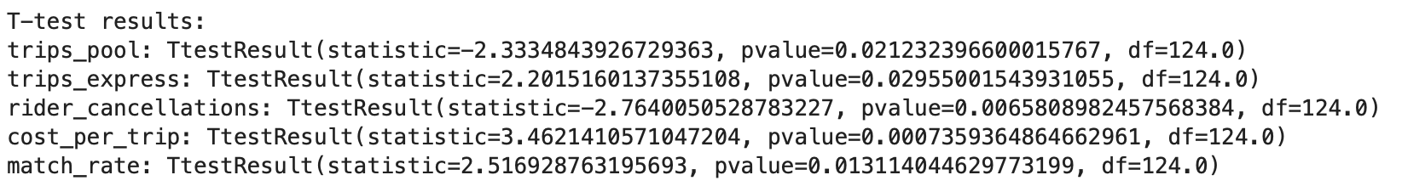
t-tests
The low p-values indicate a statistically significant difference in the count of POOL trips, Express trips, rider cancellations, cost per trip, and match rate between the two groups*.
Importance:
Distinct, identifiable effects help determine the effectiveness of the treatment.
Analysis of observed effects helps inform business decisions.
*Group 'TRUE' has observations where the treatment condition is met; (wait time = 5 mins). Group 'FALSE' has observations where the treatment condition is not met; (wait time is 2 mins).

Slide 14
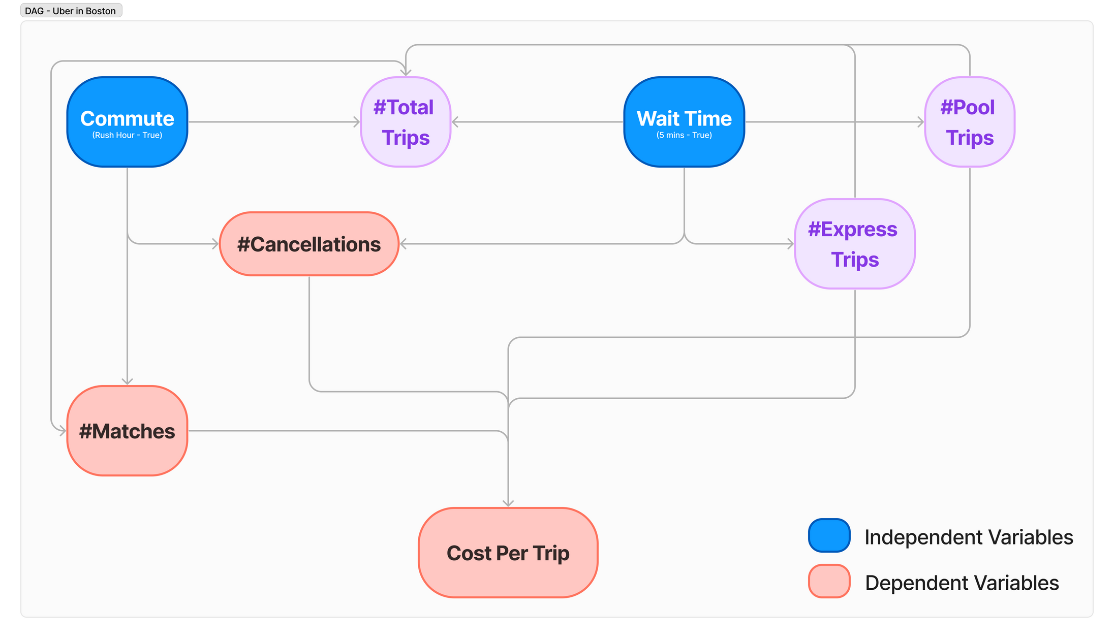
Impact Of The Treatment - DAG

Slide 15
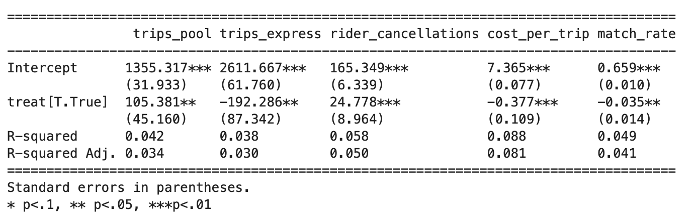
Impact Of The Treatment On Metrics
Key Observations:
Wait time alone is not a strong determinant of cancellations.
Wait time only explains ~9% of the variation in the reduction of cost per trip.

Slide 16
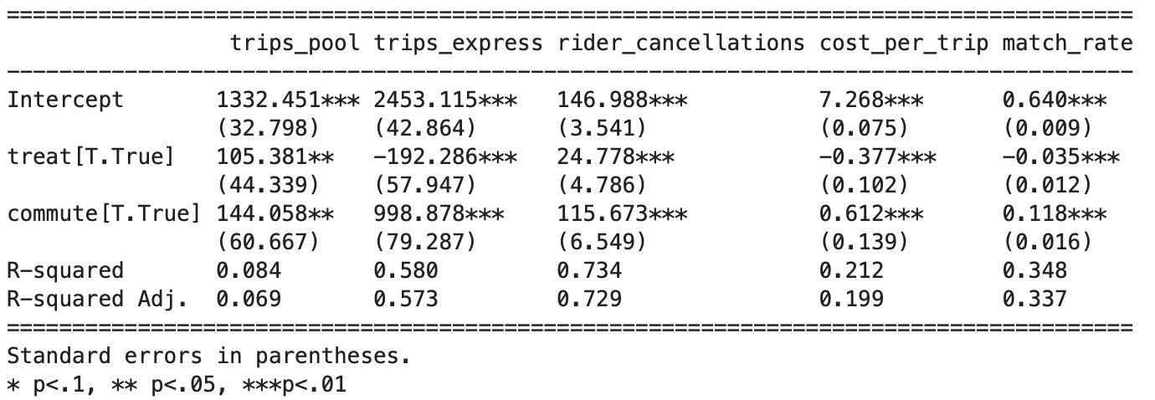
Impact Of The Treatment On Metrics
Key Observations:
The coefficients of the treat variable do not change.
Treat and commute variables explain ~75% of the variance in cancellations.
New Regression adequately captures the variability in dependent variables relevant to our business objectives.

Slide 17

Insights & Business Outcomes

Slide 18
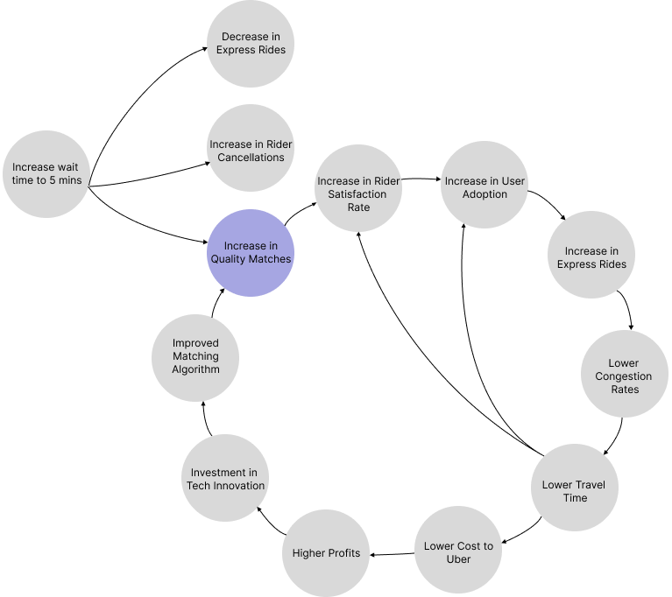
Action Items
Introduce dynamic waiting time
2 mins during rush hours
5 mins during non-rush hours
Uber Express POOL Fly Wheel
Aim: Create virtuous cycles that can help continually build capabilities that create value for Uber.
Notes:
In this way, we can create virtuous cycles that can help continually build capabilities that creates value for the Org.

Slide 19
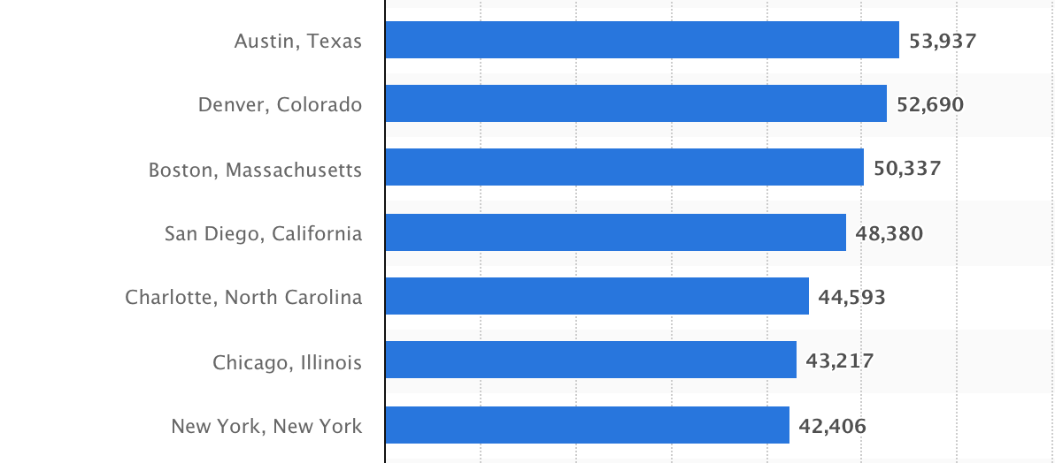


Data Limitations
Data on revenue generated from trips for POOL and Express Pool
Match rates specific to trip type
Historic rider cancellation rates
Unable to expand to other cities due to Selection Bias
Per capita income in the most populated cities in the US
High income
Higher education level

Slide 20
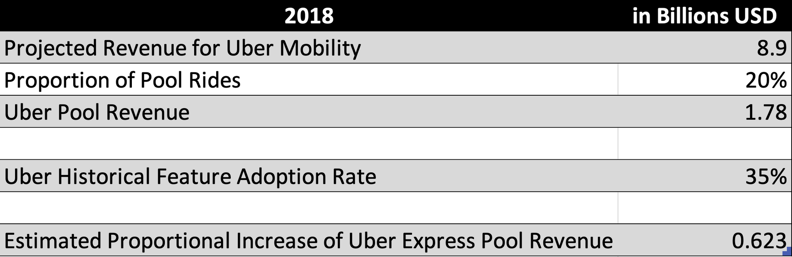

Business Value

Slide 21
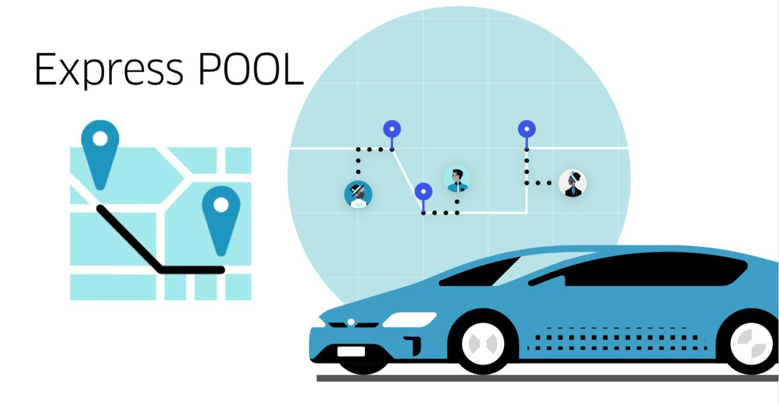
Thank You!

Slide 22
Sources
businessofapps.com. (2024, January 08). Uber Revenue and Usage Statistics (2024). Retrieved from Business Of Apps: https://www.businessofapps.com/data/uber-statistics/
Farronato, C., MacCormack, A., & Mehta, S. (2020). Innovation at Uber: The Launch of Express POOL. Harvard Business School 619.003, pp. 1–21.
Lo, J., & Morseman, S. (2019, January 24). The Perfect uberPOOL: A Case Study on Trade-Offs. Retrieved from AnthroSource: https://doi.org/10.1111/1559-8918.2018.01204
Statista. (2023, November 03). Per capita income in the most populated cities in the United States in 2021 (in U.S. dollars). Retrieved from statista.com: https://www.statista.com/statistics/205618/per-capita-income-in-the-top-20-most-populated-cities-in-the-us/
Uber. (2020, February 2020). Uber Announces Results for Fourth Quarter and Full Year 2019. Retrieved from investor.uber.com: https://investor.uber.com/news-events/news/press-release-details/2020/Uber-Announces-Results-for-Fourth-Quarter-and-Full-Year-2019/

